Slide 1
Next-Level Skills for Early Childhood Educators
Session 4: Oral Communication

Slide 2

Activity:
What is oral communication? What does it mean to you?
Give examples of when you use oral communication during your day at work
What are the advantages? Disadvantages?
Notes:
Group discussion
You could make a list of examples, advantages, disadvantages

Slide 3

Oral Communication – Body Language
Non-verbal signals make up a huge part of our daily communication. The things we don’t say can still convey volumes of information:
Facial expressions
Eyes
Mouth
Gestures
Arms and legs
Posture
Personal space
Notes:
Facial expressions – emotions, level of trust, universal
Eyes – gaze, blinking, pupil size
Mouth – pursed lips, lip biting, covering the mouth, turned up or down
Gestures – clenched fist, thumbs up or down, “okay” gesture
Arms and legs – crossed, hands on hips, clasping hands behind back, fidgeting
Posture – open, closed
Personal space – distance: intimate, personal, social, public

Slide 4

Video Clip – Non-Verbal Cues
What can the TV show “Friends” teach us about the Importance of Non-Verbal Cues?
https://www.youtube.com/watch?v=OvEci5Bjgd4
Notes:
Show video and discuss

Slide 5
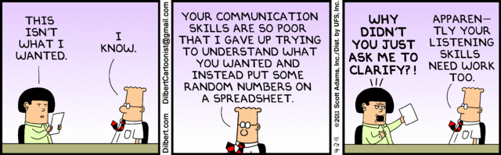
Communication Tips
Be aware of your tone and body language; use eye contact that is appropriate; be aware of personal space
When you are unclear ask for clarification
It is ok to disagree but give concrete reasoning and offer suggestions

Slide 6

Communication Tips
Listen, stay calm and show interest; be patient with the other person; show empathy
If you have no time to talk, don’t pretend you do. Inform the person now is not a good time and set up a time that you can both agree on
When you have concern with a certain individual, go directly to them; avoid gossiping – it hurts everyone in the end

Slide 7

Communication Tips
Stay on track – leave past out of it
Be as honest as you can and speak for yourself
Don’t take things personally; be able to receive and give constructive criticism

Slide 8
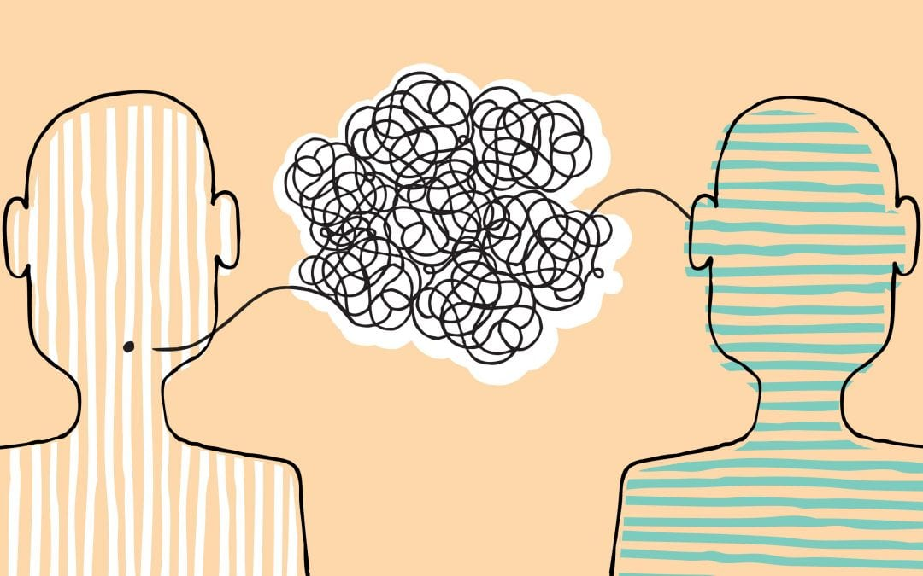
Activity: What Can Derail Communication?
Think about and discuss the different things that can derail communication or make it difficult

Slide 9
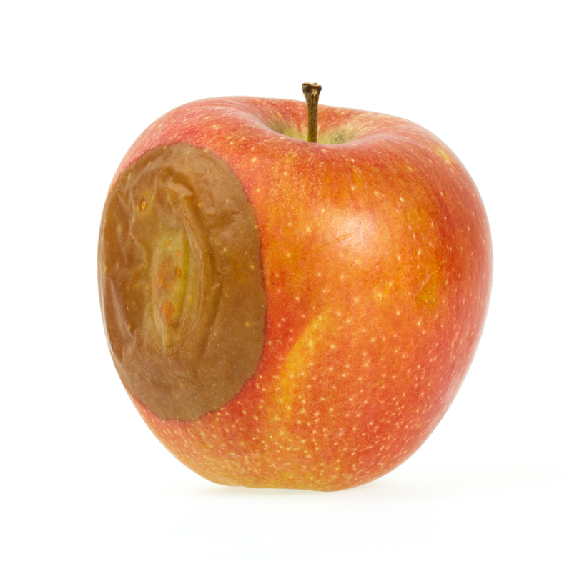
Communication Spoilers
Criticizing
Name-calling
Diagnosing
Ordering
Threatening
Moralizing
Excessive/inappropriate questioning
Logical argument
Reassuring
Advising
Diverting

Slide 10

Activity: Making Communication Better
Think about and discuss how you can make communication even better

Slide 11

Communication Enhancers
Watch your body language
Get rid of unnecessary fillers (“um”)
Have a script prepared for small talk or other occasions
Ask questions and repeat what the other person said
Tell a story
Put away distractions
Tailor your message for your audience
Be brief yet specific
Up your empathy
Really listen

Slide 12

Registers of Language
Frozen – language that is always the same
Formal – the standard syntax and word choice of work and
school; has complete sentences and specific word choices
Consultative – formal register when used in conversation; discourse pattern not quite as direct as formal register
Casual – language between friends and is characterized by a 400 – 800 word vocabulary; word choice general and not specific; conversation dependent upon non-verbal assists; sentence syntax often incomplete
Intimate – language between lovers or twins; language of sexual harassment
Notes:
Discuss why the registers of language matter – importance of message, who your audience is

Slide 13
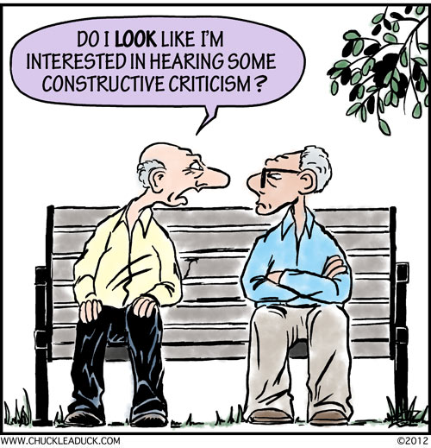
Accepting and giving constructive criticism
Be mindful of your body language
Be prepared
Remain calm and don’t respond with angry excuses
Rethink the word “criticism” as “feedback”
Show gratitude
Talk privately

Slide 14

Accepting and giving constructive criticism
Insert the negative between two positives
Highlight the issue, not the person
Give specific details
Provide suggestions on how to improve
Be available
Follow up with additional feedback

Slide 15

Video - Bully a Plant
How does talking to plants affect their growth and development?
https://www.youtube.com/watch?v=Yx6UgfQreYY

Slide 16
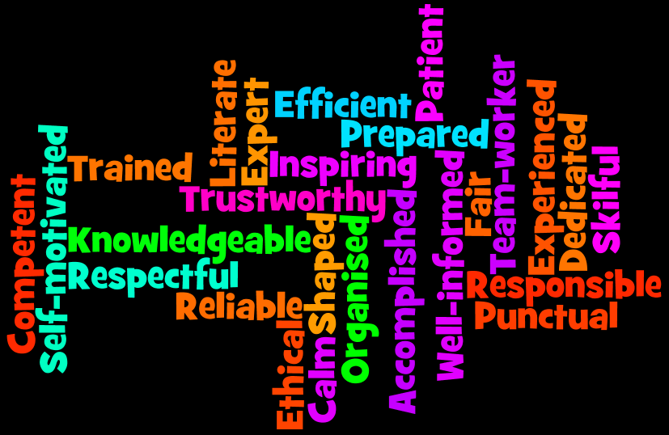
Characteristics of Professionalism
Attitude
Appearance
Behaviour
Vocabulary
Mind-set
Obstacles
Notes:
Document: Characteristics of Professionalism

Slide 17

Activity – Role Play Scenarios
Split into groups of 2 or 3 people
Practice/role play the scenario you are given
Take turns in each role
Notes:
Document: Role Play Scenarios for Session 4

Slide 18

Journal Reflection
Think about one or two things that you do well when communicating orally / verbally.
What are you good at?
Think about one or two things that you would like to improve on with oral communication.
What are they?
Notes:
Facilitator note: You do not need to advance to the next screen for the group – it is for identification purposes only.

Slide 19


Acknowledgements:
This presentation was designed in 2019 to support Ontario’s Early Childhood Educators in further developing the unique communication skills required in their role. It should be used with the accompanying Participant Workbook, and Reflection Journal.
Curriculum developed by: Carolyn Little and Helen Krygsman
Editing and design support by: Summer Burton
Support for this project was provided by:
Organizations are encouraged to copy and use these materials; however, reproducing or reselling these materials for profit is prohibited. If you have questions about this curriculum, we invite you to contact Literacy Link South Central at 519-681-7307 or literacylink@llsc.on.ca

Slide 20
Sources
Cherry, K. (2018). Understanding Body Language and Facial Expressions. https://www.verywellmind.com/understand-body-language-and-facial-expressions-4147228
DeVol, P., Payne, R.K., Dreussi Smith, T. (2006). Bridges Out of Poverty: Strategies for Professionals and Communities Workbook. Highlands, TX. aha! Process, Inc.
Gottsman, D. (2015). How to Accept and Give Professional Criticism with Grace. https://www.inc.com/diane-gottsman/how-to-accept-and-give-professional-criticism-with-grace.html
Pinola, M. (2014). Top 10 Ways to Improve Your Communication Skills. https://lifehacker.com/top-10-ways-to-improve-your-communication-skills-1590488550

